Slide 1
C++ Programming
Week 1. Introduction
Dr. Owen Chen Cary Chinese School
Director of Math and Computer Science
2023 Summer

Slide 2
Agenda Today
A Little History of C/C++ Programming Language
Areas of Application and Popularity
C++ Philosophy
C++ Weaknesses
The Course
Installation and Hello World!

Slide 3
A Little History of C/C++
Programming Language

Slide 4

The Assembly Programming Language
main:
.Lfunc_begin0:
push rbp
.Lcfi0:
.Lcfi1:
mov rbp, rsp
.Lcfi2:
sub rsp, 16
movabs rdi, .L.str
.Ltmp0:
mov al, 0 call printf xor ecx, ecx
mov dword ptr [rbp - 4], eax mov eax, ecx
add rsp, 16 pop rbp
ret
.Ltmp1:
.Lfunc_end0:
.L.str:
.asciz
A long time ago, in a galaxy far, far away....there was Assembly
Extremely simple instructions
Requires lots of code to do simple tasks
Can express anything your computer can do
Hard to read, write
...redundant, boring programming, bugs pro- liferation
"Hello World\n"

Slide 5
A Little History of C
In the 1969 Dennis M. Ritchie and Ken Thompson (AT&T, Bell Labs) worked on developing an operating system for a large computer that could be used by a thousand users. The new operating system was called UNIX
The whole system was still written in assembly code. Besides assembler and Fortran, UNIX also had an interpreter for the programming language B. A high-level language like B made it possible to write many pages of code task in just a few lines of code. In this way the code could be produced much faster than in assembly
A drawback of the B language was that it did not know data-types (everything was expressed in machine words). Another functionality that the B language did not provide was the use of “structures”. The lag of these things formed the reason for Dennis
M. Ritchie to develop the programming language C. In 1988 they delivered the final
standard definition ANSI C

Slide 6
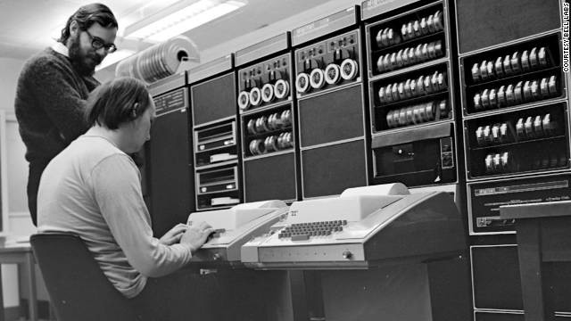
A Little History of C
Dennis M. Ritchie, and Ken Thompson
#include "stdio.h"
int main() {
printf("Hello World\n");
}

Slide 7

A Little History of C
Areas of Application:
UNIX operating system
Computer games
Due to their power and ease of use, C were used in the programming of the special effects for Star Wars
Star Wars - The Empire Strikes Back

Slide 8
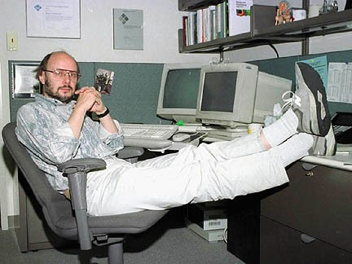
A Little History of C++
The C++ programming language (originally named “C with Classes”) was devised by Bjarne Stroustrup also an employee from Bell Labs (AT&T). Stroustrup started working on C with Classes in 1979.
The first commercial release of t he C ++ l anguage was in October 1985

Slide 9
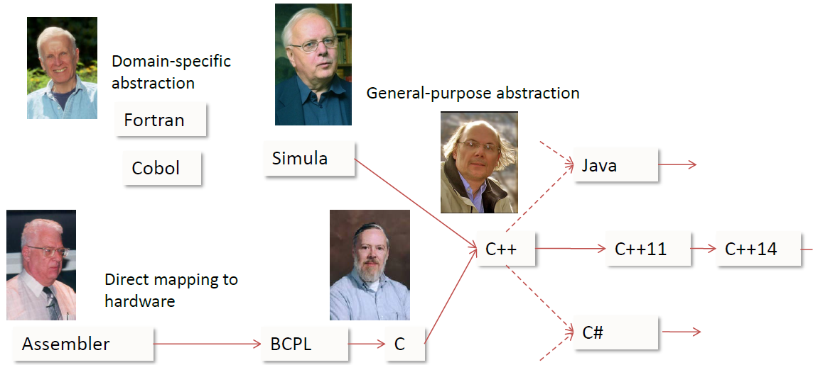
A Little History of C++
The roots of C++
“The Evolution of C++Past, Present, and Future”, B. Stroustrup, CppCon16

Slide 10
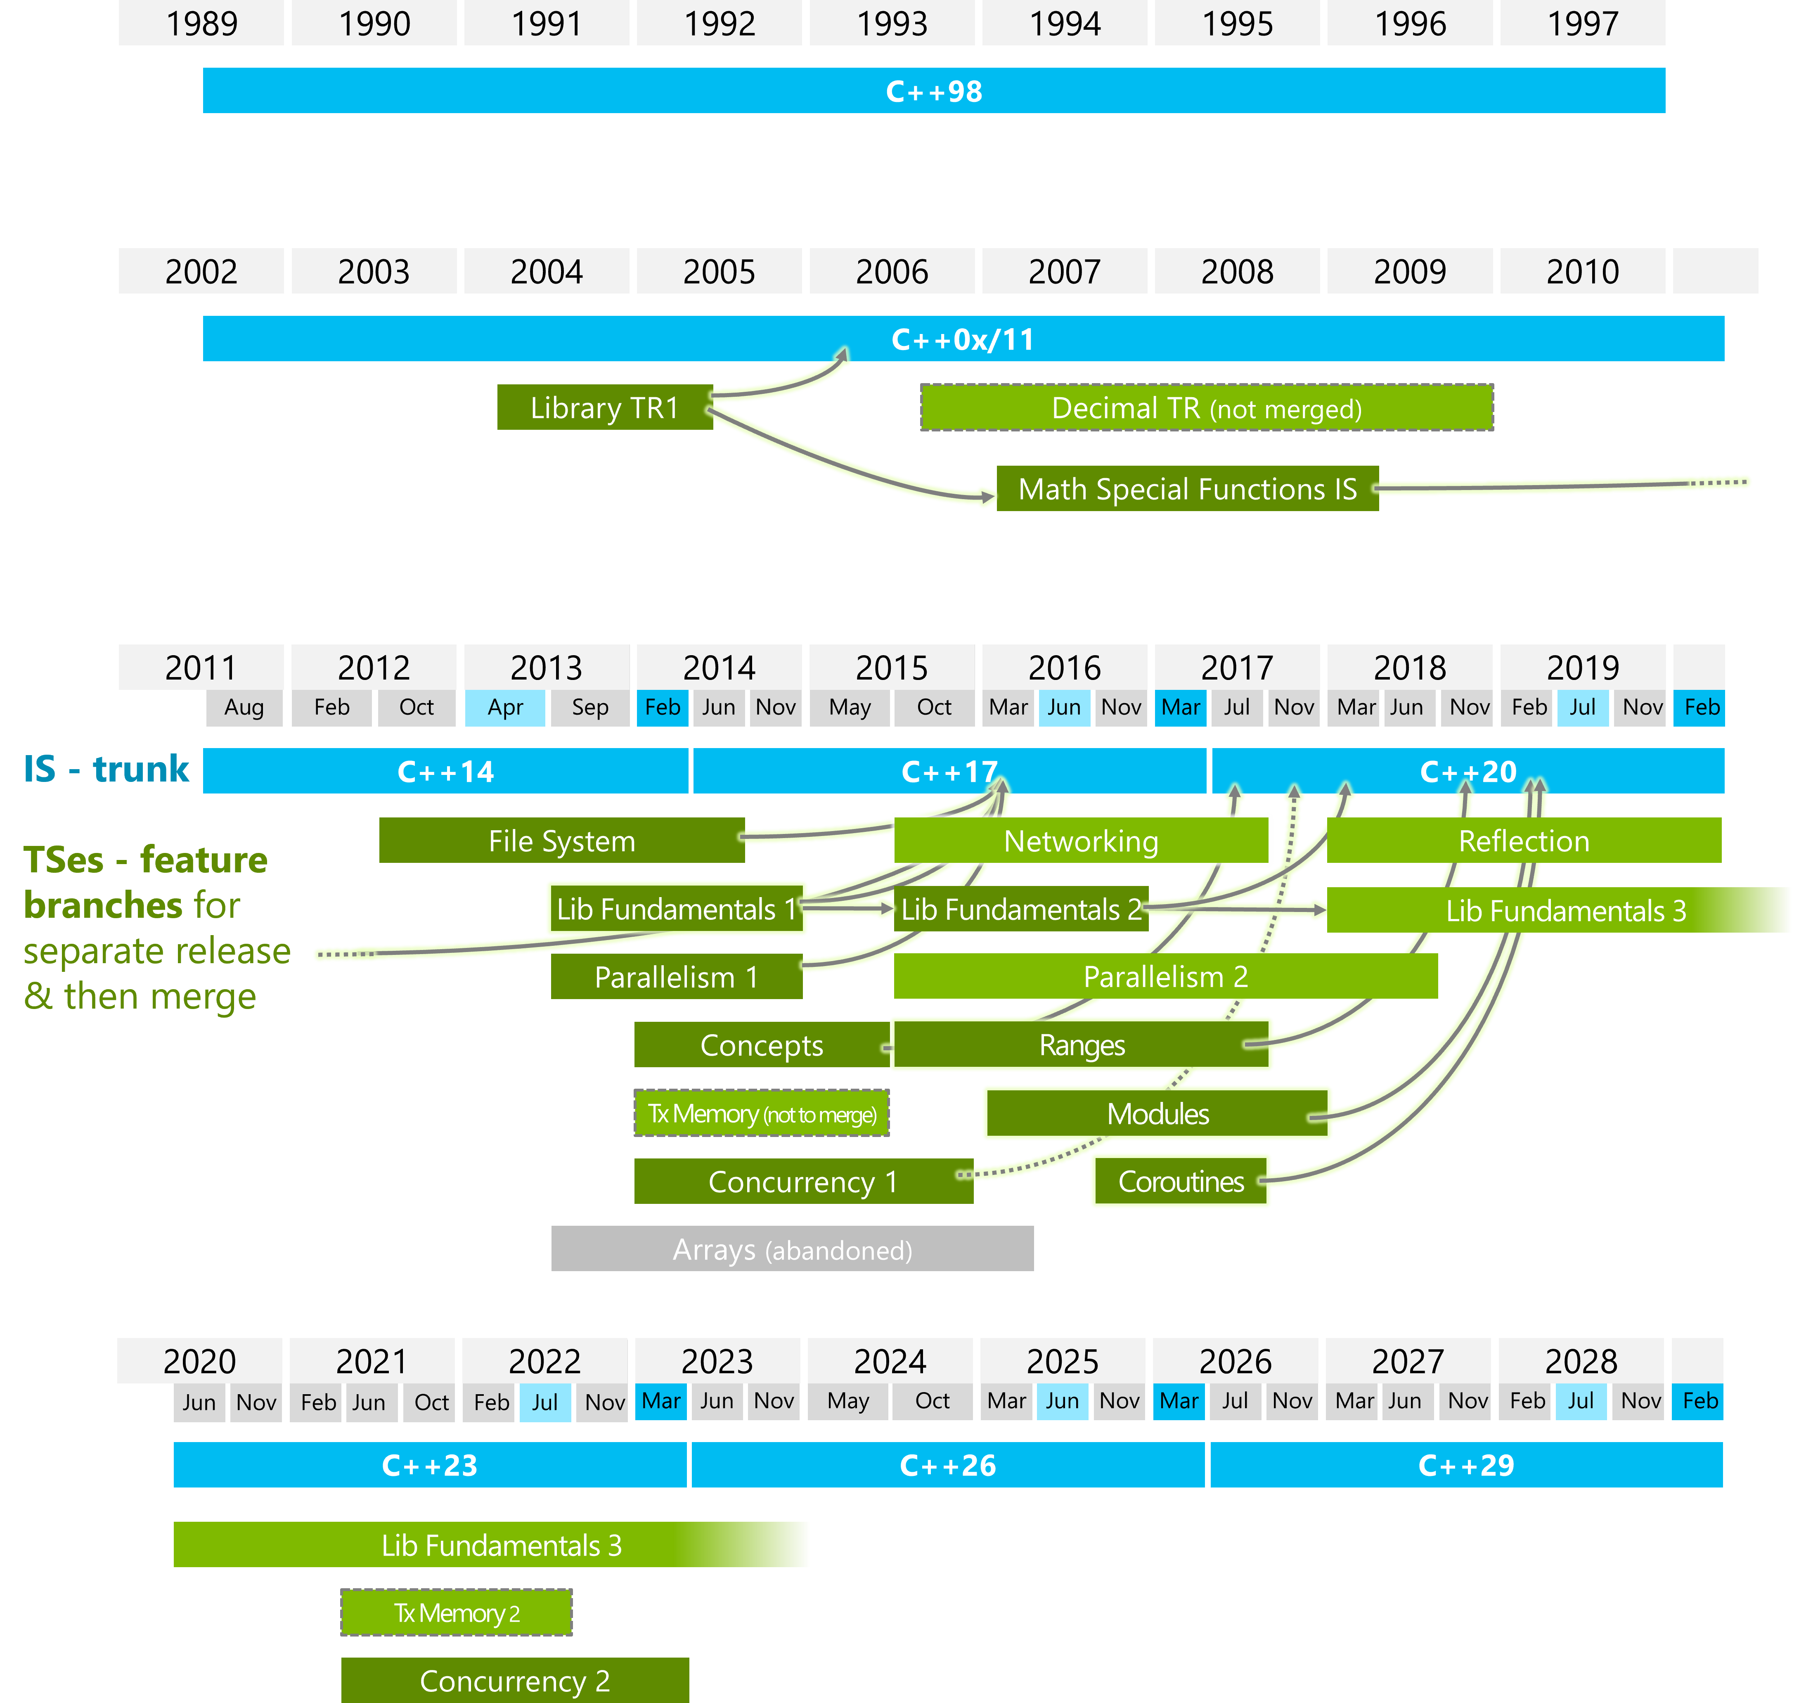
A Little History of C++

Slide 11
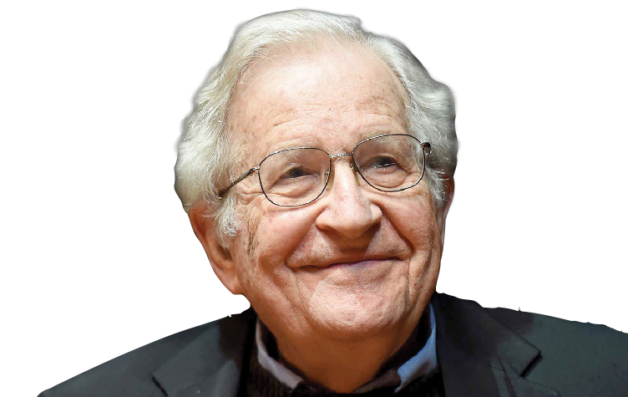
About Evolution
“If you’re teaching today what you were teaching five years ago, either the field is dead or you are”
Prof. Noam Chomsky, MIT
father of modern linguistics

Slide 12
Areas of Application and Popularity

Slide 13
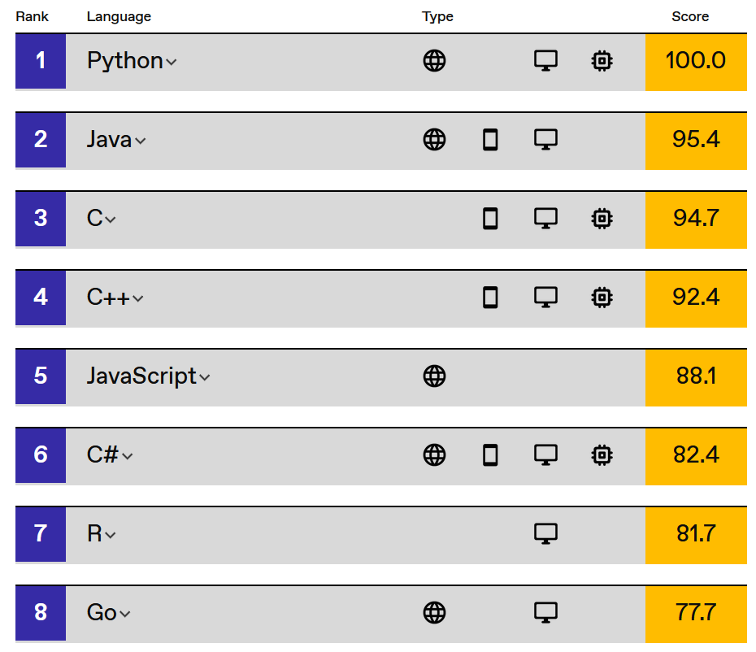
Most Popular Programming Languages (IEEE Spectrum - 2022)
Interactive: The Top Programming Languages 2022

Slide 14
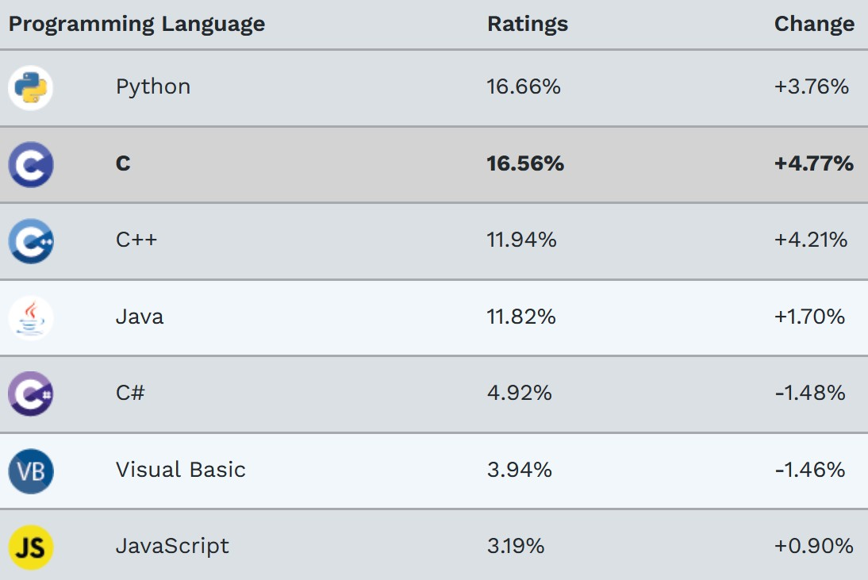
Most Popular Programming Languages (TIOBE - December. 2022)
www.tiobe.com/tiobe-index/

Slide 15
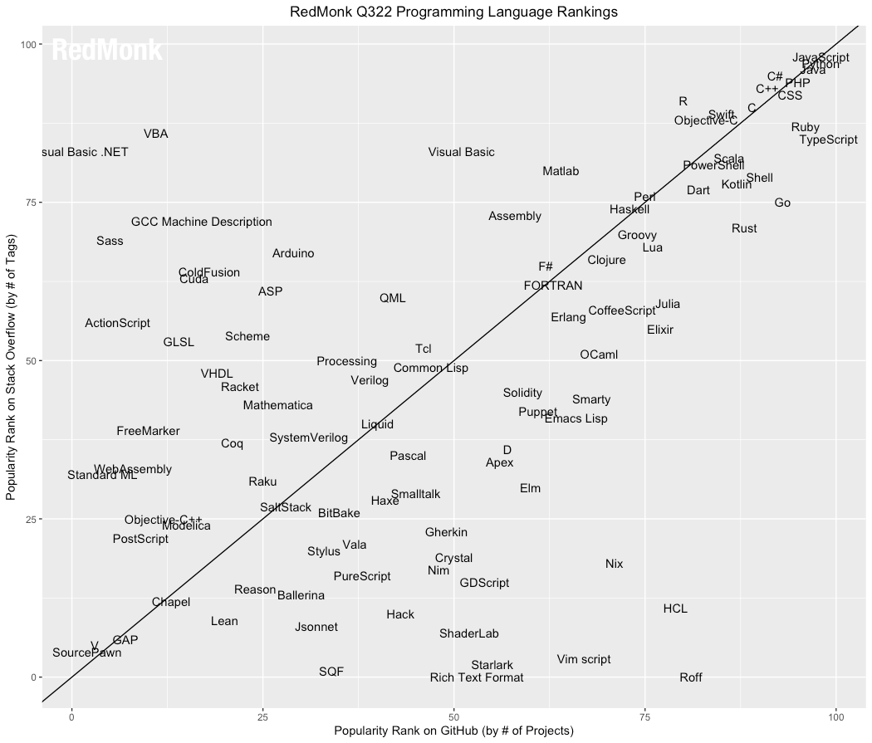
Most Popular Programming Languages (Redmonk - June, 2022)
redmonk.com

Slide 16
Why C++ is so Popular?
1/2
There may be more than 200 billion lines of C/C++ code globally
Performance is the defining aspect of C++. No other programming language provides the performance-critical facilities of C++
Provide the programmer control over every aspect of performance
Leave no room for a lower level language
Total number of lines of all code in use?

Slide 17
Why C++ is so Popular?
2/2
Ubiquity. C++ can run from a low-power embedded device to large-scale supercomputers
Multi-Paradigm. Allow writing efficient code without losing high-level abstraction
Allow writing low-level code. Drivers, kernels, assembly (asm), etc.
Ecosystem. Many support tools such as debuggers, memory checkers, coverage, static analysis, profiling, etc.
Maturity. C++ has a 40 years history. Many software problems have been already addressed and developing practices have been investigated

Slide 18
Areas of Application
1/2
Operating systems: Windows, Android, OS X, Linux
Compilers: LLVM, Swift compiler
Artificial Intelligence: TensorFlow, Caffe, Microsoft Cognitive Toolkit
Image Editing: Adobe Premier, Photoshop, Illustrator
Web browser: Firefox, Chrome, etc. + WebAssembly
High-Performance Computing: drug developing and testing, large scale climate models, physic simulations
Embedded systems: IoT, network devices (e.g. GSM), automotive
Google and Microsoft use C++ for web indexing

Slide 19
Areas of Application 2/2
Scientific Computing: CERN/NASA*, SETI@home, Folding@home
Database: MySQL, ScyllaDB
Video Games: Unreal Engine, Unity
Entertainment: Movie rendering (see Interstellar black hole rendering), virtual reality
Finance: electronic trading systems (Goldman, JPMorgan, Deutsche Bank)**
... and many more
* The flight code of the NASA Mars drone for the Perseverance Mission, as well as the Webb telescope software, are mostly written in C++ github.com/nasa/fprime, James Webb Space Telescope’s Full Deployment

Slide 20
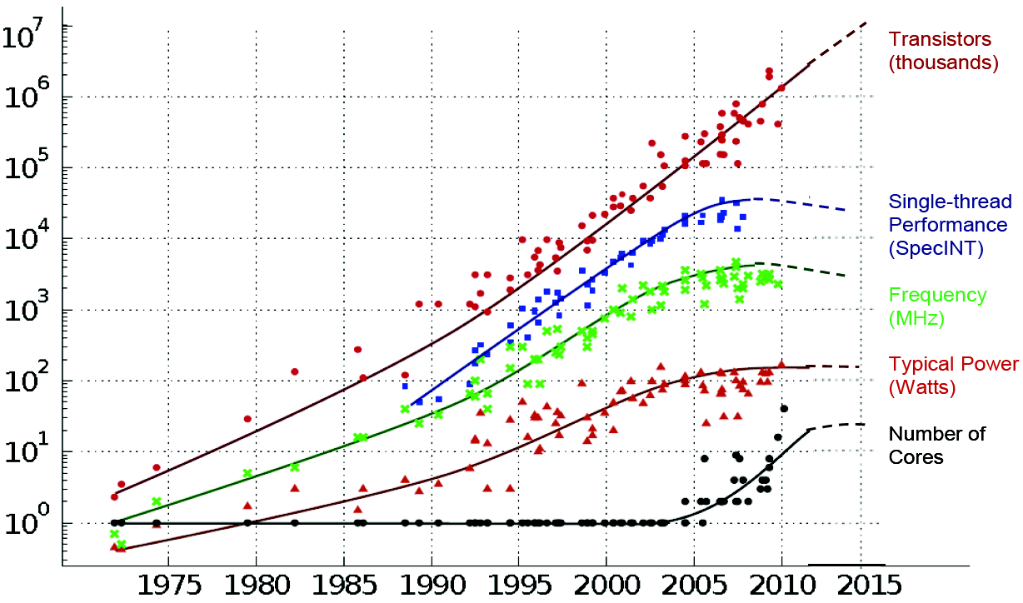
Why C++ is so Important?
The End of Historical Performance Scaling
Performance limitations influence algorithm design and research directions

Slide 21
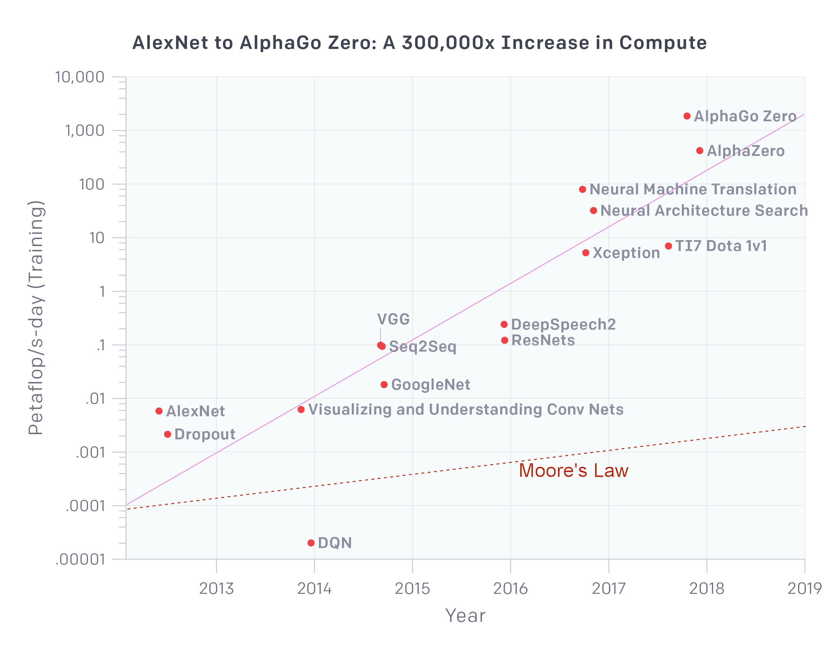
An Important Example... (AI Evolution)

Slide 22







Performance
1/3
N-BODY SIMULATION
P RO G R A M M ING L A N G UAGES P E R FO R M A NC E CO M PA R I SON
900
800
700
600
500
400
300
200
100
0
780
660
Execution TIme (S)
360
300
8.23
21.47
21.96
22.1
26.61
JAVA Node.js PHP
Programming Language
C++
GO
SWIFT
Ruby
Perl
Python3

Slide 23
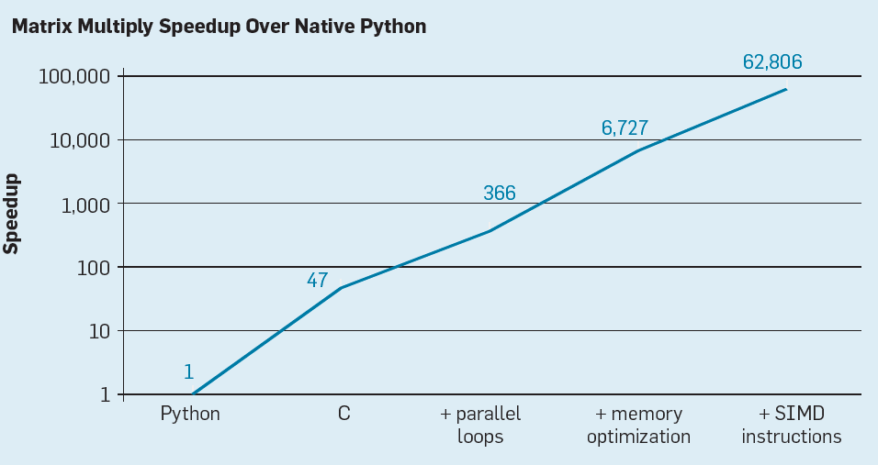
Performance
2/3
”A New Golden Age for Computer Architecture“, J. L. Heneessey, D. A. Patterson, 2019

Slide 24
Performance
3/3
Hello World
Language | Execution Time
C (on my machine) | 0.7 ms
C | 2 ms
Go | 4 ms
Crystal | 8 ms
Shell | 10 ms
Python | 78 ms
Node | 110 ms
Ruby | 150 ms
jRuby | 1.4 s
Time to "hello world" on my machine

Slide 25






Performance/Expressiveness Trade-off
Mandelbrot Static Instructions per Line
1,000,000
100,000
10,000
1,000
100
10
1
INSTRUCTIONS PER LINE
Assembly
C
C++
Java
JS
Python

Slide 26
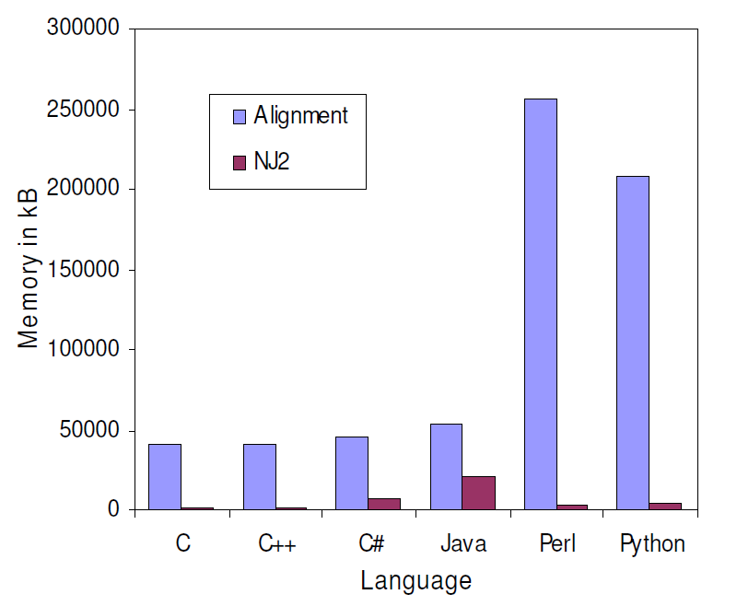
Memory Usage
Memory usage comparison of the Neighbor-Joining and global alignment programs
A comparison of common programming languages used in bioinformatics (BMC Informatic)

Slide 27
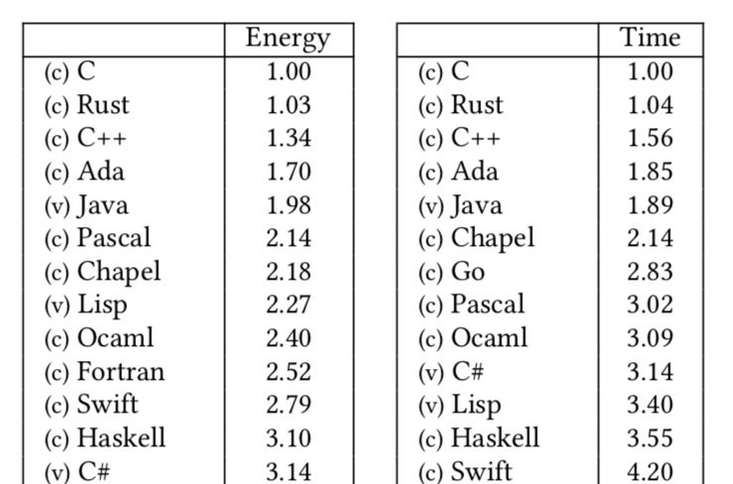
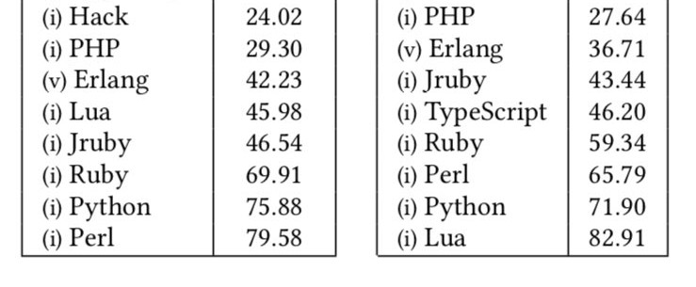
Energy Efficiency
Energy Efficiency across Programming Languages

Slide 28
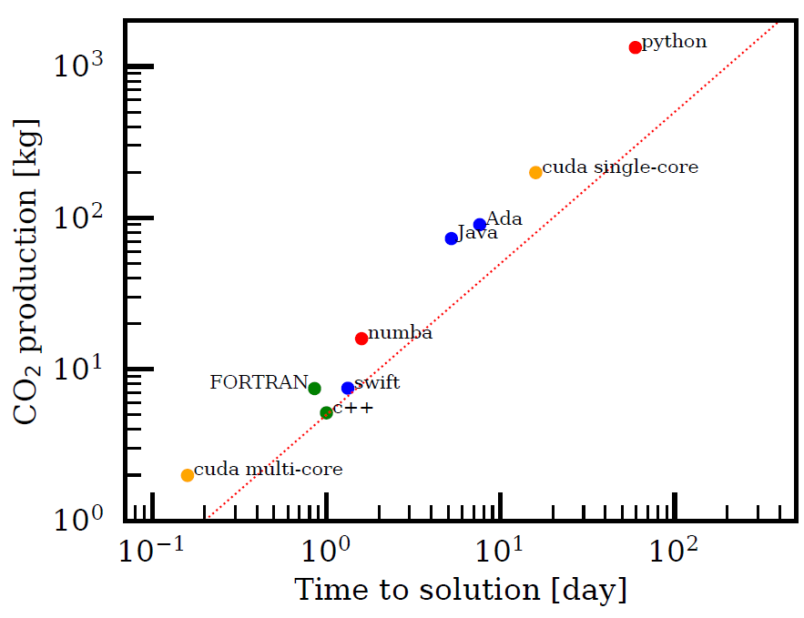
CO² Production
The Ecological Impact of High-performance Computing in Astrophysics, Nature

Slide 29
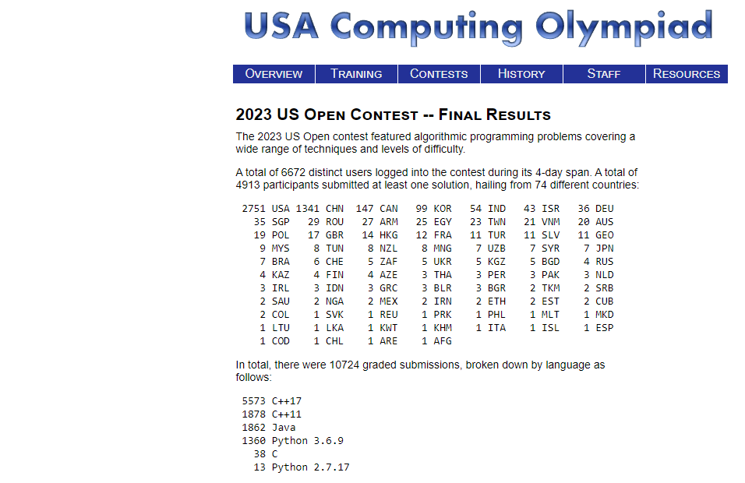
USACO

Slide 30
C++ Philosophy

Slide 31
C++ Philosophy - Performance
1/3
Do not sacrifice performance except as a last resort
Zero Overhead Principle (zero-cost abstraction)
“it basically says if you have an abstraction it should not cost anything compared to write the equivalent code at lower level”
“so I have say a matrix multiply it should be written in a
such a way that you could not drop to the C level of abstrac- tion and use arrays and pointers and such and run faster”
Bjarne Stroustrup

Slide 32
C++ Philosophy - Type Safety
2/3
Enforce safety at compile time whenever possible
Statically Typed Language
“The C++ compiler provides type safety and catches many bugs at compile time instead of run time (a critical consideration for many commercial applications.)”
www.python.org/doc/FAQ.html
The type annotation makes the code more readable
Promote compiler optimizations and runtime efficiency
Allow users to define their own type system

Slide 33
C++ Philosophy
3/3
Programming model: compartmentalization, only add features if they solve an actual problem, and allow full control
Predictable runtime (under constraints): no garbage collector, no dynamic type system → real-time systems
Low resources: low memory and energy consumption →
restricted hardware platforms
Well suited for static analysis → safety critical software
Portability → Modern C++ standards are highly portable

Slide 34
Who is C++ for?
“C++ is for people who want to use hardware very well and manage the complexity of doing that through abstrac- tion”
Bjarne Stroustrup
“a language like C++ is not for everybody. It is gener- ated via sharp and effective tool for professional basically and definitely for people who aim at some kind of precision”
Bjarne Stroustrup

Slide 35
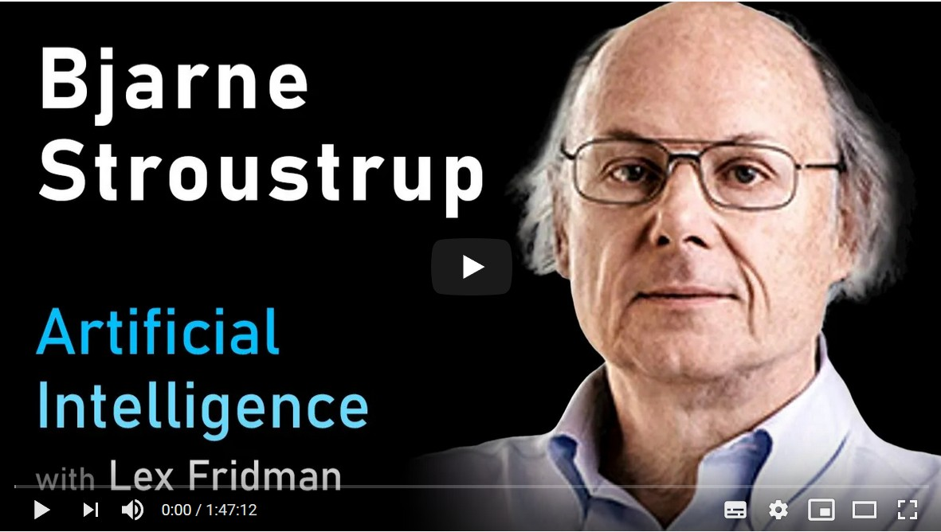
Suggested Video

Slide 36
C++ Weaknesses

Slide 37
Why C++ is so Difficult?
1/2
... and why teaching C++ as first programming language is a bad idea?
C++ is the hardest language from students to master
More languages in one
Standard C/C++ programming
Preprocessor
Object-Oriented features
Templates and Meta-Programming
Huge set of features
Worry about memory management
Low-level implementation details: pointer arithmetics, structure, padding, undefined behavior, etc.
Frustrating : compiler/runtime errors (e.g. seg. fault)

Slide 38
Why C++ is so Difficult?
2/2
“C makes it easy to shoot yourself in the foot; C++ makes it harder, but when you do, it blows your whole leg off”
Bjarne Stroustrup, Creator of the C++ language
“The problem with using C++...is that there’s already a strong ten- dency in the language to require you to know everything before you can do anything”
Larry Wall, Creator of the Perl language
“Despite having 20 years of experience with C++, when I compile a non-trivial chunk of code for the first time without any error or warning, I am suspicious. It is not, usually, a good sign”
Daniel Lemire, Prof. at the University of Quebec

Slide 39
C++ Weaknesses
Backward-compatibility
‘‘Dangerous defaults and constructs, often originating from C, cannot be removed or altered”
“Despite the hard work of the committee, newer features sometimes have flaws that only became obvious after extensive user experience, which cannot then be fixed”
“C++ practice has put an ever-increasing cognitive burden on the developer for what I feel has been very little gain in productivity or expressiveness and at a huge cost to code clarity”

Slide 40
C++ Weaknesses
C++ critics and replacements:
Epochs: a backward-compatible language evolution mechanism
Goals and priorities for C++
Carbon Language
Circle C++ Compiler
Cppfront: Can C++ be 10x simpler & safer ... ?

Slide 41
Language Complexity
Every second spent trying to understand the language is one not spent understanding the problem

Slide 42
References
1/3
(Un)official C++ reference:*
en.cppreference.com
Tutorials:
www.learncpp.com
www.tutorialspoint.com/cplusplus
en.wikibooks.org/wiki/C++
yet another insignificant...programming notes
Other resources:
stackoverflow.com/questions/tagged/c++
* The full C++ standard draft can be found at eel.is/c++draft/full
Don’t open it! it is a html web page of 32 MB!

Slide 43
References
3/3
News:
isocpp.org (Standard C++ Foundation)
cpp.libhunt.com/newsletter/archive
www.meetingcpp.com/blog/blogroll/
Main conferences:
www.meetingcpp.com (slides)
cppcon.org (slides)
isocpp.com conference list
Coding exercises and other resources:
www.hackerrank.com/domains/cpp
leetcode.com/problemset/algorithms
open.kattis.com
cpppatterns.com

Slide 44
The Course

Slide 45
The Course: 9 Weeks on C++20/C++23
Week 1: Installation and hello world program
Week 2: Flow Control and Basic Variable Types
Week 3: Strings, Vectors and Arrays
Week 4: Expressions and Operators
Week 5: Statements
Week 6: Functions
Week 7: Classes
Week 8: C++ Library
Week 9: Project

Slide 46
“The only way to learn a new pro- gramming language is by writing pro- grams in it”
Dennis Ritchie
Creator of the C programming language

Slide 47
Installation

Slide 48
Software Installs
Install WSL on Windows
Install VS Code
Install C++ Compiler
Configure VS Code

Slide 49
Install WSL on Windows
Windows Subsystem for Linux (WSL) is required for this course
Please install it by following this page:
https://learn.microsoft.com/en-us/windows/wsl/install
Follow this page to set up a username and a password for your Linux account:
https://learn.microsoft.com/en-us/windows/wsl/setup/environment#set-up-your-linux-username-and-password
Write down your password – if you will need later when you run “sudo” command

Slide 50
Install VS Code
Download VS Code here: https://code.visualstudio.com/
Follow the setup instruction:
Windows:https://code.visualstudio.com/docs/setup/windows
Mac: https://code.visualstudio.com/docs/setup/mac

Slide 51
What Compiler Should I Use?
Most popular compilers:
Microsoft Visual Code (MSVC) is the compiler offered by Microsoft
The GNU Compiler Collection (GCC) contains the most popular C++ Linux compiler
Clang is a C++ compiler based on LLVM Infrastructure available for Linux/Windows/Apple (default) platforms
Suggested compiler on Linux for beginner: Clang
Comparable performance with GCC/MSVC and low memory usage
Expressive diagnostics (examples and propose corrections)
Strict C++ compliance. GCC/MSVC compatibility (inverse direction is not ensured)
Includes very useful tools: memory sanitizer, static code analyzer, automatic formatting, linter, etc.

Slide 52
Install the Compilers
Install the last gcc/g++ on WSL
$ sudo apt update
$ sudo apt install gcc g++
$ gcc --version
$ g++ --version
Install the last clang on Mac
Run the following command from a terminal (iTerm):
The above command will install C++ compiler clang
$ xcode-select --install

Slide 53
What Editor/IDE Compiler Should I Use?
1/2
Commercial C++ IDE (Integrated Development Environment):
Microsoft Visual Studio (MSVC). Most popular IDE for Windows
Clion. Powerful IDE with a lot of options
QT-Creator. Fast (written in C++), simple
Free C++ IDE:
Microsoft Visual Studio Code (VS Code)
XCode. Default on Mac OS
Cevelop
Eclipse
Not suggested : Notepad, Gedit, and other similar editors - lack of support for programming

Slide 54
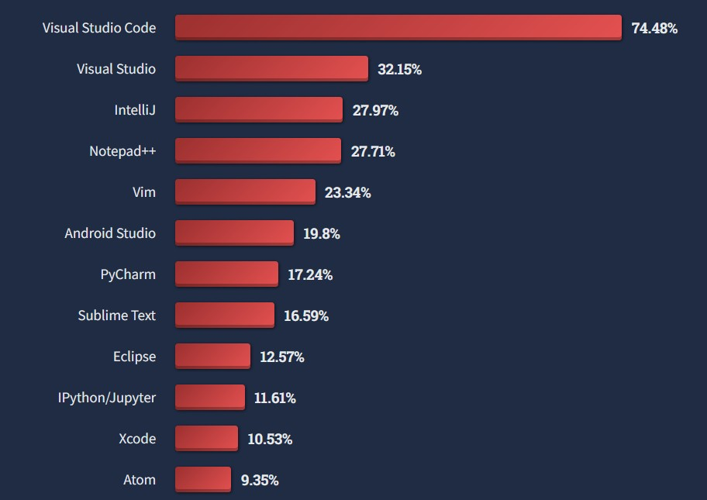
What Editor/IDE Compiler Should I Use?
2/2
StackOverflow Developer Survey 2022

Slide 55
How to Compile?
Compile C++11, C++14, C++17, C++20, C++23 programs:
g++ -std=c++11 <program.cpp> -o program
g++ -std=c++14 <program.cpp> -o program g++ -std=c++17 <program.cpp> -o program g++ -std=c++20 <program.cpp> -o program
g++ -std=c++23 <program.cpp> -o program
Any C++ standard is backward compatible
C++ is also backward compatible with C, even for very old code, except if it contains C++ keywords (new, template, class, typename, etc.)
We can potentially compile a pure C program in C++23

Slide 56
C++ Standard
1/2
Compiler | C++11 Core Library |  | C++14 Core Library |  | C++17 Core Library |  | C++20/C++23 Core Library
g++ | 4.8.1 | 5.1 | 5.1 | 5.1 | 7.1 | 9.0 | 11+ | 11+
clang++ | 3.3 | 3.3 | 3.4 | 3.5 | 5.0 | 11.0 | 12+ | 14+
MSVC | 19.0 | 19.0 | 19.10 | 19.0 | 19.15 | 19.15 | 19.29+ | 19.29
en.cppreference.com/w/cpp/compiler support

Slide 57
Hello World

Slide 58
Hello World
1/2
C code with printf :
C++ code with streams :
#include <stdio.h>
int main() {
printf("Hello World!\n");
}
#include <iostream>
int main() {
std::cout << "Hello World!\n";
}
printf
cout
prints on standard output
represent the standard output stream

Slide 59
Hello World
2/2
The previous example can be written with the global namespace:
std
#include <iostream>
using namespace std;
int main() {
cout << "Hello World!\n";
}
Note: For sake of space and for improving the readability, we intentionally omit the
std
namespace in the next slides

Slide 60
I/O Stream (std::cout)
1/3
std::cout
is an example of output stream. Data is redirected to a destination, in
this case the destination is the standard output
C:
#include <stdio.h>
int main() {
int a
= 4;
= 3.0;
double b
char c[] = "hello"; printf("%d %f %s\n", a, b, c);
}
C++:
#include <iostream>
int main() {
int a
double b
= 4;
= 3.0;
char c[] = "hello";
std::cout << a << " " << b << " " << c << "\n";
}

Slide 61
I/O Stream (Why should we prefer I/O stream?)
2/3
Type-safe: The type of object provided to the I/O stream is known statically by the
compiler. In contrast, uses % fields to figure out the types dynamically
printf
Less error prone: With IO Stream, there are no redundant % tokens that have to be consistent with the actual objects pass to I/O stream. Removing redundancy removes a class of errors
Extensible: The C++ IO Stream mechanism allows new user-defined types to be pass to I/O stream without breaking existing code
Comparable performance: If used correctly may be faster than C I/O ( printf ,
scanf , etc.) .

Slide 62
I/O Stream (Common C errors)
3/3
Forget the number of parameters:
printf("long phrase %d long phrase %d", 3);
Use the wrong format:
int a = 3;
...many lines of code... printf(" %f", a);
The %c conversion specifier does not automatically skip any leading white space:
scanf("%d", &var1);
scanf(" %c", &var2);

Slide 63
Online Practices
3/3
codewars.com
Create a free account
Add a Clan: CCS

